Slide 1
LAN Cabling
Notes:
‹#›

Slide 2
Implementing UTP
‹#›

Slide 3
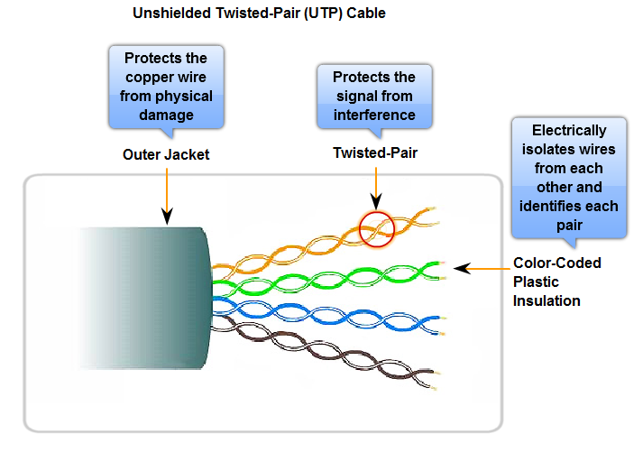
Unshielded Twisted Pair (Pair)
‹#›

Slide 4
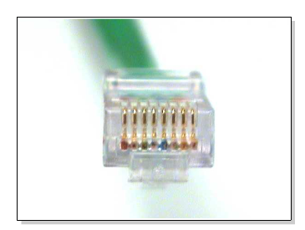
RJ-45 Connector
‹#›

Slide 5
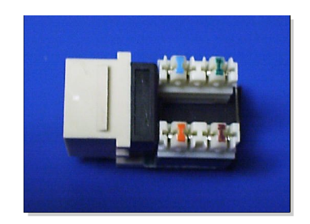
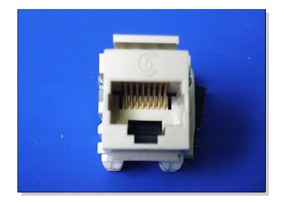
RJ-45 Jack
Front View
Top down View
‹#›

Slide 6
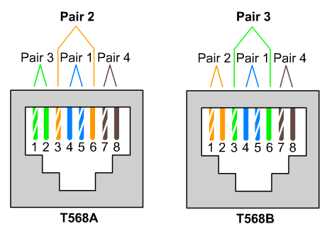
T568A and T568B Color Code
‹#›

Slide 7
Cabling Instruction
Determine the EIA/TIA category of cable
Use the documentation of the device
Look for a label on the device near the jack.
Otherwise use Category 5E or greater
Determine the type of Connection
Straight Through
Crossover
Make proper connection following color code (TIA568A or TIA568B)
‹#›
Notes:
EIA/TIA Wiring Standards are standards for commercial and telecommunications wiring developed by the Electronic Industries Alliance (EIA) and Telecommunications Industry Association (TIA).
Ethernet technologies can be used in a campus network in several different ways:
10 Mbps at the user level to provide good performance.
100 Mbps for clients or servers that require more bandwidth.
Fast or Gigabit Ethernet between backbone devices.
‹#›

Slide 8
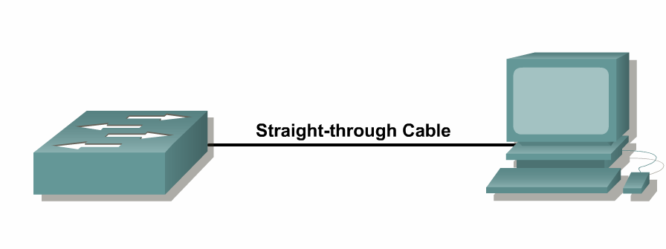
Straight-through Cable
Connects different layer devices
Switch to router
Switch to PC or server
Hub to PC or server
Orders of colored wires are same at each end of connection
‹#›

Slide 9
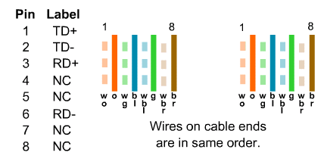
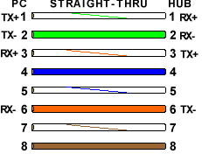
Straight-through Cable
‹#›

Slide 10
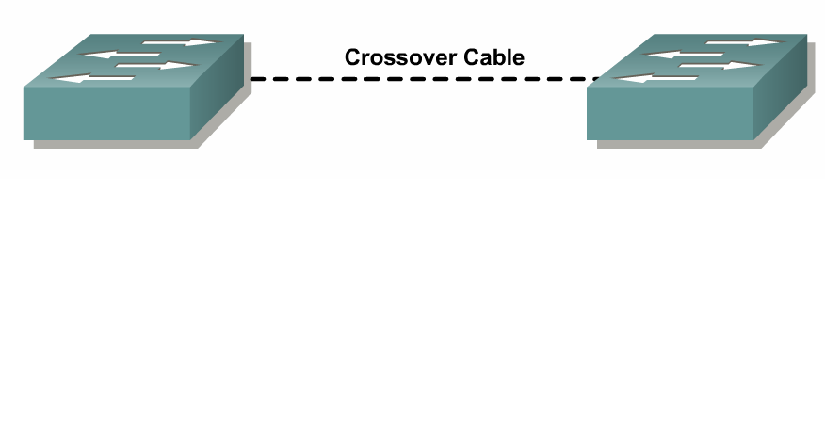
Crossover Cable
Connects Similar Devices
Switch to switch
Switch to hub
Hub to hub
Router to router
PC to PC
Router to PC
‹#›

Slide 11
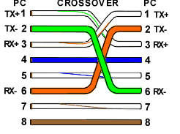
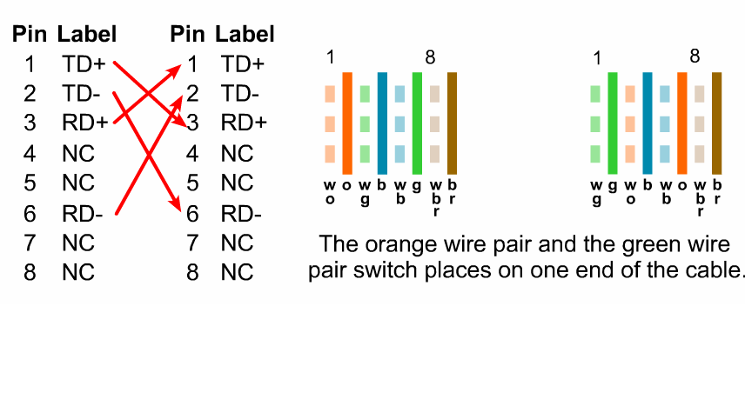
Crossover Cable
‹#›

Slide 12
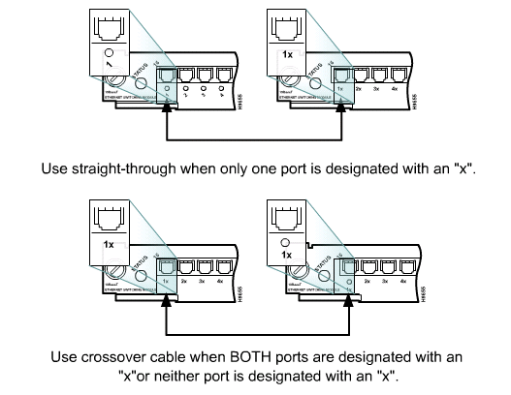
Connecting Cisco Devices
‹#›

Slide 13
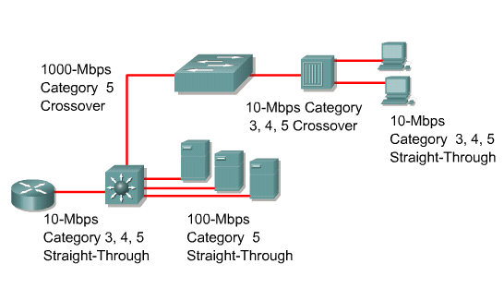
Interconnecting Devices
‹#›

